Slide 1
数据库专题训练
数据库新型检索技术
近似查询
计算机系软件所数据库组 李国良
DB Training - Approximate String Search

Slide 2
Outline
Motivation
Similarity Functions
Approximate String Search Algorithms
DB Training - Approximate String Search

Slide 3
Outline
Motivation
Similarity Functions
Approximate String Search Algorithms
DB Training - Approximate String Search

Slide 4
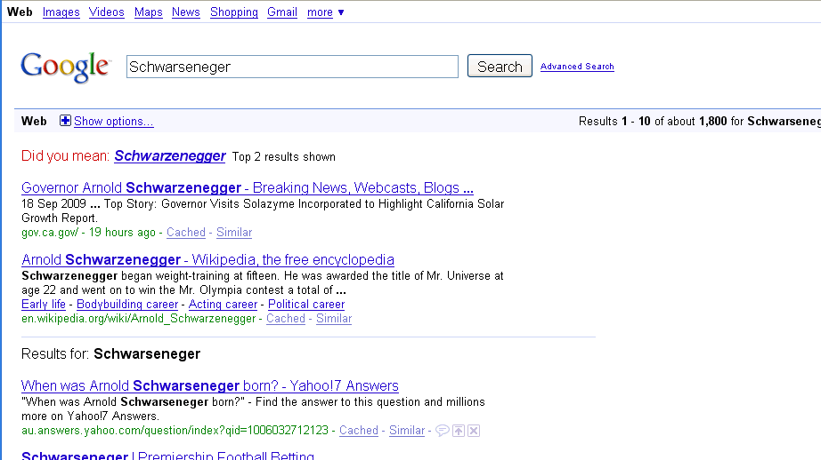
Motivation (Web Search)
DB Training - Approximate String Search

Slide 5
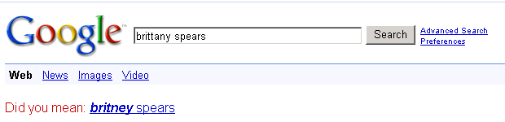

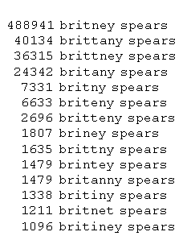
Motivation (Web Search)
Errors in queries
Errors in data
Bring query and meaningful results closer together
Actual queries gathered by Google
http://www.google.com/jobs/britney.html
DB Training - Approximate String Search

Slide 6

Motivation (Spell checking)
DB Training - Approximate String Search

Slide 7


Example: a movie database
Iron man
The man
Find movies starred Samuel Jackson
Star | Title | Year | Genre
Keanu Reeves | The Matrix | 1999 | Sci-Fi
Samuel Jackson | Iron man | 2008 | Sci-Fi
Schwarzenegger | The Terminator | 1984 | Sci-Fi
Samuel Jackson | The man | 2006 | Crime
DB Training - Approximate String Search

Slide 8


Query: Schwarzenegger?
The user doesn’t know the exact spelling!
Star | Title | Year | Genre
Keanu Reeves | The Matrix | 1999 | Sci-Fi
Samuel Jackson | Iron man | 2008 | Sci-Fi
Schwarzenegger | The Terminator | 1984 | Sci-Fi
Samuel Jackson | The man | 2006 | Crime
DB Training - Approximate String Search

Slide 9
Relaxing Conditions
Find movies with a star “similar to” Schwarrzenger.
Star | Title | Year | Genre
Keanu Reeves | The Matrix | 1999 | Sci-Fi
Samuel Jackson | Iron man | 2008 | Sci-Fi
Schwarzenegger | The Terminator | 1984 | Sci-Fi
Samuel Jackson | The man | 2006 | Crime
DB Training - Approximate String Search

Slide 10
Gap between Queries and Data
Errors in the query
  The user does not remember a string exactly
  The user unintentionally types a wrong string
Query: Schwarrzenger.
Data : Schwarzenegger
DB Training - Approximate String Search

Slide 11
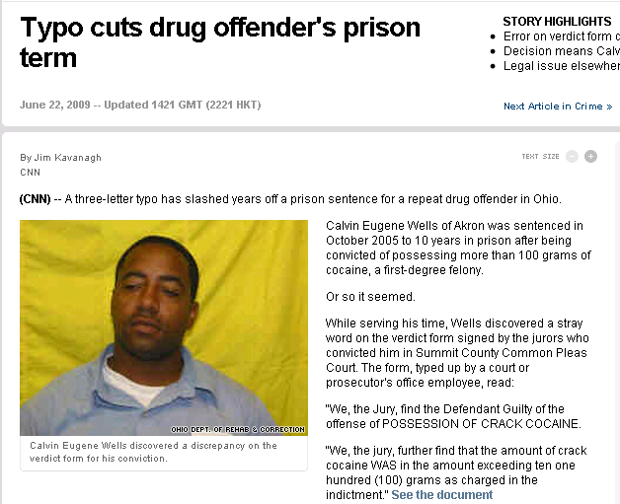
Importance of Data Quality
Source:
CNN
DB Training - Approximate String Search

Slide 12
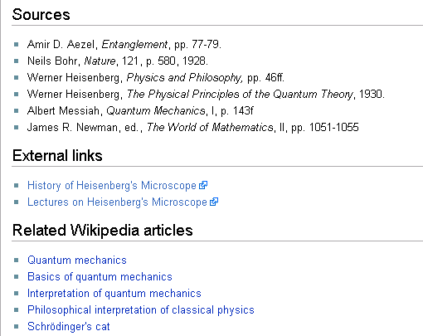
Document Cleaning
Should be “Niels Bohr”
Source: http://en.wikipedia.org/wiki/Heisenberg's_microscope
DB Training - Approximate String Search

Slide 13
State-of-the-art: Oracle 10g and Older
Supported by Oracle Text
CREATE TABLE engdict(word VARCHAR(20), len INT);
Create preferences for text indexing:
begin ctx_ddl.create_preference('STEM_FUZZY_PREF', 'BASIC_WORDLIST'); ctx_ddl.set_attribute('STEM_FUZZY_PREF','FUZZY_MATCH','ENGLISH'); ctx_ddl.set_attribute('STEM_FUZZY_PREF','FUZZY_SCORE','0'); ctx_ddl.set_attribute('STEM_FUZZY_PREF','FUZZY_NUMRESULTS','5000'); ctx_ddl.set_attribute('STEM_FUZZY_PREF','SUBSTRING_INDEX','TRUE'); ctx_ddl.set_attribute('STEM_FUZZY_PREF','STEMMER','ENGLISH'); end; /
CREATE INDEX fuzzy_stem_subst_idx ON engdict ( word ) INDEXTYPE IS ctxsys.context PARAMETERS ('Wordlist STEM_FUZZY_PREF');
Usage:
SELECT * FROM engdict
WHERE CONTAINS(word, 'fuzzy(universisty, 70, 6, weight)', 1) > 0;
Limitation: cannot handle errors in the first letters:
  Katherine versus Catherine
DB Training - Approximate String Search

Slide 14
Microsoft SQL Server
Data cleaning tools available in SQL Server 2005
Part of Integration Services
Supports fuzzy lookups
Uses data flow pipeline of transformations
Similarity function: tokens with TF/IDF scores
DB Training - Approximate String Search

Slide 15
Lucene
Using Levenshtein Distance (Edit Distance).
Example: roam~0.8
Prefix filtering followed by a scan
DB Training - Approximate String Search

Slide 16
Outline
Motivation
Similarity Functions
Approximate String Search Algorithms
DB Training - Approximate String Search

Slide 17
Similarity Functions
Similar to: A domain-specific similarity function
  Input : two strings
  Output: a similarity value between the two strings
Examples:
  Character-based similarity
    Edit distance
    Hamming distance
  Token-based similarity
    Jaccard similarity
    Cosine similarity
    DICE
    TF/IDF
  Soundex
DB Training - Approximate String Search

Slide 18
Character-based similarity
Computing similarity based on characters
Transforming a string to another based on characters
DB Training - Approximate String Search

Slide 19
Hamming Distance
The number of different characters between two strings
Example:
  R=AGCTACTC
  S =AGTTCCTC
  H(R, S) = 2
DB Training - Approximate String Search

Slide 20
Edit Distance
A widely used metric to define string similarity
Ed(s1,s2) = minimum # of operations (insertion, deletion, substitution) to change s1 to s2
Example:
s1: Tom Hanks
s2: Ton Hank
ed(s1, s2) = 2
DB Training - Approximate String Search

Slide 21
Another example
Suppose we have two strings x,y
e.g. x = kitten
y = sitting
and we want to transform x into y.
We use edit operations:
1. insertions
2. deletions
3. substitutions
DB Training - Approximate String Search

Slide 22
How to?
A closer look:
k i t t e n
s i t t i n g
1st step: kitten →sitten (substitution)
2nd step: sitten→sittin (substitution)
3rd step: sittin→sitting (insertion)
DB Training - Approximate String Search

Slide 23
Some interesting properties
ED(x,y) ≥ 0
ED(x,y) = ED(y,x)
ED(x, y) = 0 iff x = y
Triangle Inequality: for any three strings x,y,z of arbitrary lengths:
ED(x,y) ≤ ED(x,z) + ED(z,y)
Metric space!
DB Training - Approximate String Search

Slide 24
Dynamic Programming Algorithm
A = a₁ a₂ … a_{m}
B = b₁ b₂ … b_{n}
D_{i,j} = edit distance of a₁ a₂ … a_{i} and b₁ b₂ … b_{j.}
D_{i,0} = i, 0 ≤ i ≤ m
D_{0,j} = j, 0 ≤ j ≤ n
D_{i,j} = min{D_{i-1, j} + 1,
D_{i, j-1} + 1,
D_{i-1, j-1} + t_{i, j}}, 1 ≤ i ≤ m, 1 ≤ j ≤ n
where t_{i, j} = 0 if a_{i} = b_{j} and t_{i, j} = 1 if a_{i} ≠ b_{j}.
DB Training - Approximate String Search

Slide 25
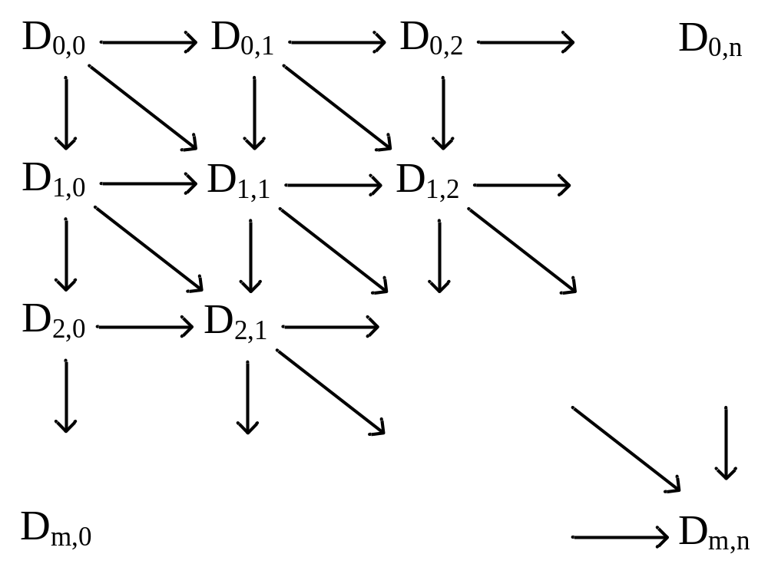
Dynamic Programming Algorithm
Distance matrix:
Time complexity: O(mn)
DB Training - Approximate String Search

Slide 26
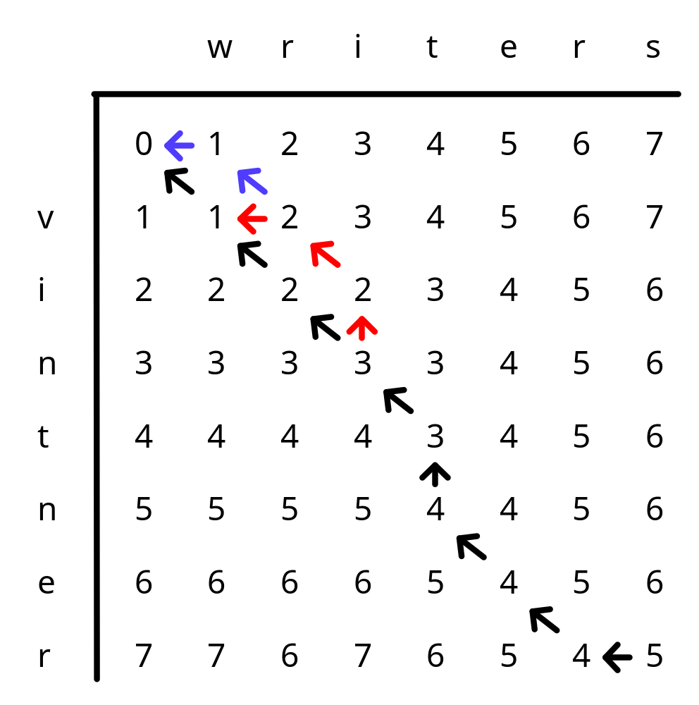
Dynamic Programming: A=‘vintner’, B=‘writers’
The 3 optimal alignments : -:gap
wri-t-ers
v-intner-
wri-t-ers
-vintner-
writ-ers
vintner-
DB Training - Approximate String Search

Slide 27
Term (token) based Function
Varying semantics of ‘term’
  Words in a field
    ‘AT&T Corporation’ -> ‘AT&T’ , ‘Corporation’
  Q-grams (sequence of q-characters in a field)
    3-grams
    {‘AT&’, ’T&T’, ’&T ‘, ‘T C’, ’ Co’, ’orp’, ’rpo’, ’por’, ’ora’, ’rat’, ’ati’, ’tio’, ’ion’}
    Assess similarity by manipulating sets of terms.
DB Training - Approximate String Search

Slide 28
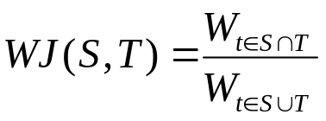
Jaccard Similarity
Given two sets of terms S, T
  Jaccard similarity: Jaccard(S,T) = |S∩T|/|S∪T|
  S={a, b, c}, T={b, c, d}
  Jaccard(S, T) = 2/4
Another example
  R={Intel Corporation}, S={Intel Corp.}, T={Microsoft Corporation}
  Jaccard(R, S) = 1/3, Jaccard(R, T) = 1/3
    Weighted Jaccard
    where W_{t} is the weight of term t.
DB Training - Approximate String Search

Slide 29
TF/IDF
Term frequency (tf)
Inverse document frequency (idf).
Widely used in traditional IR approaches.
The tf/idf value of a ‘term’ in a document:
  W = log₂(tf+1) * idf where
    tf : # of times ‘term’ appears in a document d
    idf : number of documents / number of documents containing ‘term’
  Intuitively: rare ‘terms’ are more important
  D1: computer science database ir
  D2: computer science ir
  D3: computer science data mining data integration (tf(data)=2)
  idf(computer) = 3/3 = 1 idf(ir) = 3/2 = 1.5
DB Training - Approximate String Search

Slide 30
Weighted Jaccard
Given two sets of terms, S and T, their weighted Jaccard Similarity
  S: computer science db ir
  T: computer science ir dm
  W _{“ computer”} = 1*1 =1; W _{“ science”} = 1*1 =1
  W _{“ ir”} = 1*1 =1; W _{“ db”} = W _{“ dm”} =1*2 =2
  J (S, T) = 3/5
  WJ(S, T) = 3/7
DB Training - Approximate String Search

Slide 31
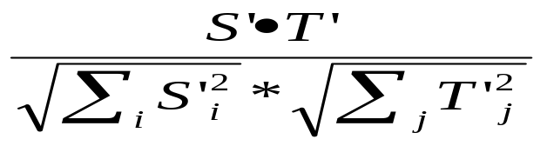
Cosine similarity
Transform each set to a (sparse) vector.
Use cosine of two vectors to define similarity
  S: computer science db ir
  T: computer science ir dm
  V = computer science ir db dm
  S’ = 1 1 1 1 0
  T’ = 1 1 1 0 1
  Cosine(S’, T’) =
  Cosine(S’, T’) = 3/2*2 = 3/4
DB Training - Approximate String Search

Slide 32
Cosine Similarity
Suitable to assess closeness of
    ‘AT&T Corporation’, ‘AT&T Corp’ or ‘AT&T Inc’
      Low weights for ‘Corporation’, ’Corp’, ’Inc’
      Higher weight for ‘AT&T’
      Overall Cosine(‘AT&T Corp’, ’AT&T Inc’) should be high
    q-grams may capture small typing mistakes
      ‘Jaccard’ vs ‘Jacard’ ->
      {‘Jac’,’acc’,’cca’,’car’,’ard’} vs {‘Jac’,’aca’,’car’,’ard’}
      Common terms ‘Jac’, ‘car’, ‘ard’ would be enough to result in high value of Cosine(‘Jaccard’, ’Jacard’).
DB Training - Approximate String Search

Slide 33
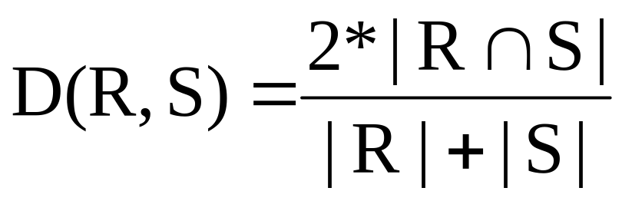
DICE
Example:
  R=AGCTACTC
  S =AGTTCCTC
  D(R, S) = 2*6/(8+8)=3/4
DB Training - Approximate String Search

Slide 34
Soundex Encoding
Code | Letters | Description
1 | B, F, P, V | Labial (唇音)
2 | C, G, J, K, Q, S, X, Z | Gutterals and sibilants
3 | D, T | Dental (齿音)
4 | L | Long liquid
5 | M, N | Nasal (鼻音)
6 | R | Short liquid
SKIP | A, E, H, I, O, U, W, Y | Vowels (and H, W, and Y) are skipped
A phonetic algorithm that indexes names by their sounds when pronounced in English. Kate vs Cate, Stone vs Sdone
Consists of the first letter of the name followed by three numbers. Numbers encode similar sounding consonants.
    Remove all W, H
    B, F, P, V encoded as 1, C,G,J,K,Q,S,X,Z as 2
    D,T as 3, L as 4, M,N as 5, R as 6, Remove vowels
    Concatenate first letter of string with first 3 numerals
Ex: great and grate become G6EA3 and G6A3E and then G63
DB Training - Approximate String Search

Slide 35
Outline
Motivation
Similarity Functions
Approximate String Search Algorithms
DB Training - Approximate String Search

Slide 36
Approximate String Search
Fuzzy Selection Queries
  Input:
    A collection of strings S
    A query q
  Output:
    those strings similar to q
    Similar to -> a similarity function and a threshold
    i.e., edit distance, threshold τ
DB Training - Approximate String Search

Slide 37


Problem Formulation
S
q
Find strings similar to a given string
Performance is important!
10 ms: 100 queries per second (QPS)
5 ms: 200 QPS
DB Training - Approximate String Search

Slide 38
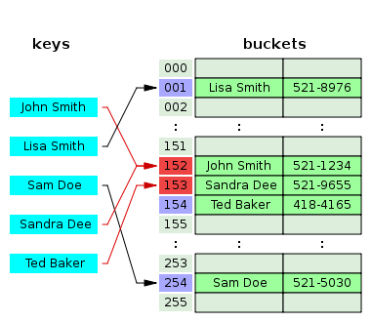
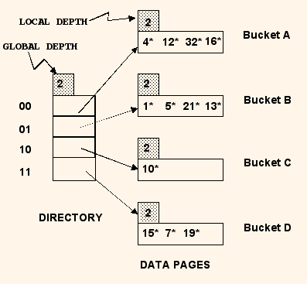
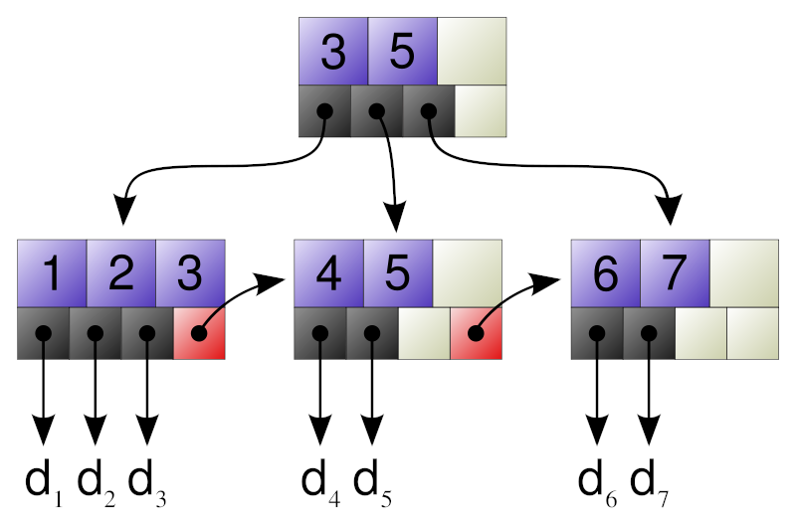
Traditional Selection Queries
Point queries: SELECT * FROM Empl WHERE ID = 81741;
Range queries: SELECT * FROM Empl WHERE salary > 50000 and salary < 65000
Indexes:
  B+-tree
  Hash tables?
DB Training - Approximate String Search

Slide 39
Naïve Solution?
Brute Force - Scan and Verify?
Enumerate all strings
Verify whether each string is similar to query q
DB Training - Approximate String Search

Slide 40
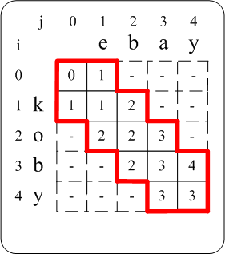
Verify Whether Two Strings are Similar?
Verify whether two strings (r, s) are similar
  Two strings are similar if their edit distance is no larger than a given edit-distance threshold τ
Complexity
    Dynamic programming O(|r||s|)
Improvement
    |j-i|<= τ
    Complexity O((2τ +1)*min(|r|,|s|))
Early termination
  Verify ED(r, s) ≤ 1
DB Training - Approximate String Search

Slide 41



Naïve solutions are very slow.
Have any efficient methods?
DB Training - Approximate String Search

Slide 42
q-gram based Methods
Filter
  Generate a subset by eliminating strings which could not be similar to the query q
  Have false positives
  Have no false negatives
Refine
    Verify the results and eliminate those false positives
DB Training - Approximate String Search

Slide 43
“q-grams” of strings
String S
u n i v e r s a l
2-grams
Gram set of S
{un, ni, iv, ve, er, rs, sa, al}
# of q-grams of s?
|s|+1-q
DB Training - Approximate String Search

Slide 44
Edit operation’s effect on grams
Fixed length: q
Insertion is the same as deletion
Substitution
Deletion
R
u n i v e r s a l
u n i v e r s a l
u m i v e r s a l
u i v e r s a l
1 operation at most affects q grams
DB Training - Approximate String Search

Slide 45
Edit operation’s effect on grams
R
u n i v e r s a l
Fixed length: q
k operations could affect k * q grams
S
u m i v e r s e l
R is similar to S within τ operations if
DB Training - Approximate String Search

Slide 46
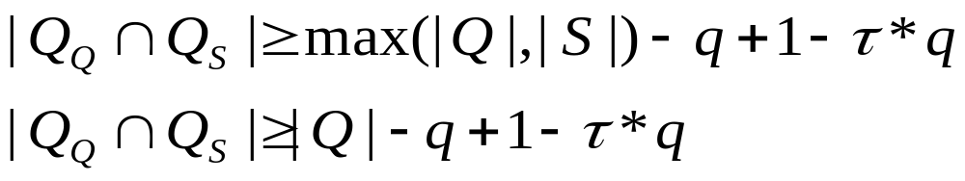
Given a query Q, for any string S, we have
Given a query Q, we find all the strings
sharing enough grams with grams of Q as candidates
DB Training - Approximate String Search

Slide 47
Transform fuzzy search (edit-distance verification) to exact gram search
How to do exact search?
Inverted Lists
DB Training - Approximate String Search

Slide 48
q-gram inverted lists
Sorted grams
String ids (sorted)
at
ch
ck
ic
ri
st
ta
ti
tu
uc
4
0
2
id strings
0
1
2
3
4
rich
stick
stich
stuck
static
1
3
2-grams
0
1
2
4
0
1
2
3
4
4
1
2
4
3
3
DB Training - Approximate String Search

Slide 49
Searching using inverted lists
Query: “shtick”, ED(shtick, ?)≤1
sh ht ti ic ck
ti
ic
ck
# of common grams >= 6+1-2-2*1=3
at
ch
ri
st
ta
tu
uc
at
ch
ck
ic
ri
st
ta
ti
tu
uc
4
0
2
id strings
0
1
2
3
4
rich
stick
stich
stuck
static
1
3
2-grams
0
1
2
4
0
1
2
3
4
4
1
2
4
3
3
DB Training - Approximate String Search

Slide 50
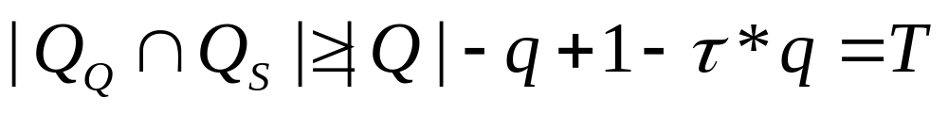
T-occurrence Problem
Query Q
Grams of Q
g1 g2 g3 g4 g5 g6 g7
......
......
Gram lists sorted in ascending order
Merge
Find elements whose occurrences ≥ T
How about duplicated grams of the query?
DB Training - Approximate String Search

Slide 51
Example
Qq={g1, g2, g3, g4, g5}
T = 4
g1 g2 g3 g4 g5
1
3
5
10
13
10
13
15
5
7
13
13
15
Result: 13
How to efficiently compute the occurrences?
DB Training - Approximate String Search

Slide 52
List-Merging Algorithms
HeapMerger
MergeOpt
[SK04]
[LLL08, BK02]
ScanCount
MergeSkip
DivideSkip
DB Training - Approximate String Search

Slide 53
ScanCount
String ids
# of occurrences
Increment by 1
1 2 3
…
0
1
1
3
5
10
13
10
13
15
5
7
13
13
15
0
1
0
Result!
13
0
4
1
14
0
15
2
0
Count threshold T≥ 4
DB Training - Approximate String Search

Slide 54
List-Merging Algorithms
HeapMerger
MergeOpt
[SK04]
[LLL08, BK02]
ScanCount
MergeSkip
DivideSkip
DB Training - Approximate String Search

Slide 55
Heap-based Algorithm
Push to heap
……
Min-heap
Count # of occurrences of each element using a heap
DB Training - Approximate String Search

Slide 56
HeapMerger
Occurrence T=2
element occurrence
3
1
minHeap
2
1
1
2
3
3
1
2
3
1
2
1
3
4
5
6
8
2
5
6
7
8
9
3
5
8
3
5
DB Training - Approximate String Search

Slide 57
List-Merging Algorithms
HeapMerger
MergeOpt
[SK04]
[LLL08, BK02]
ScanCount
MergeSkip
DivideSkip
DB Training - Approximate String Search

Slide 58
MergeSkip algorithm
Pop T-1
Min-heap
……
Jump
Greater or equals
T-1
DB Training - Approximate String Search

Slide 59
Example of MergeSkip
minHeap
1
5
10
13
15
1
3
5
10
10
15
5
7
13
15
13
13
Jump
17
17
15
15
Count threshold T≥ 4
DB Training - Approximate String Search

Slide 60
List-Merging Algorithms
HeapMerger
MergeOpt
[SK04]
[LLL08, BK02]
ScanCount
MergeSkip
DivideSkip
DB Training - Approximate String Search

Slide 61
MergeOpt Algorithm
Candidates:
Answers must be in short lists
Binary
search
If its occurrence is smaller than T-T’, pruned, where T’ is the number of unvisited lists
If its occurrences is larger than T, terminate
Long Lists: T-1
Short Lists
DB Training - Approximate String Search

Slide 62
Example of MergeOpt
13 is an answer
15 is not an answer
1
3
5
10
13
10
13
15
5
7
13
13
15
Long Lists: 3
Short Lists: 2
Count threshold T≥ 4
DB Training - Approximate String Search

Slide 63
List-Merging Algorithms
HeapMerger
MergeOpt
[SK04]
[LLL08, BK02]
ScanCount
MergeSkip
DivideSkip
DB Training - Approximate String Search

Slide 64
DivideSkip Algorithm
Binary
search
MergeSkip
Occurrence must be no smaller than T-T’ in short lists
Long Lists T’
Short Lists
DB Training - Approximate String Search

Slide 65
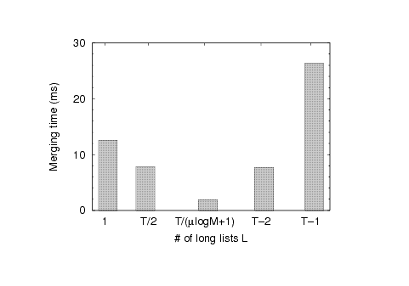
How many lists are treated as long lists?
Long Lists
Short Lists
Lookup
Merge
?
A good balance in the tradeoff:
# of long lists = T / ( μ logM +1)
where μ and M depend on datasets
DB Training - Approximate String Search

Slide 66

Filter and Refine Framework
Fewer candidates
more
filter time
less
Verification time
Strong
Tf
Tv
Filter
Overall performance
=Tf+Tv ?????
weak
More candidates
less
filter time
more
verification time
Tf
Tv
DB Training - Approximate String Search

Slide 67
How to Support Jaccard
Jaccard(R, S) ≥ τ
|R∩S|/(|R|+|S|-|R∩S|) ≥ τ
→|R∩S| ≥ τ *|R|
|R∩S| ≥ (|R|+|S|)* τ / (1 + τ )
→|R∩S| ≥ (|R|+|Smin|)* τ / (1 + τ )
Given Q:
|G_{Q}∩G_{S}| ≥ max (τ *|G_{Q}|, (|G_{Q}|+|G_{Smin}|)*τ/(1+τ))
Smin is the string with the shortest length
DB Training - Approximate String Search

Slide 68
How to Support DICE
DICE(R, S) ≥ τ
2|R∩S|/(|R|+|S|) ≥ τ
→ |R∩S| ≥ τ /2*(|R|+|Smin|)
Given query q:
|G_{Q}∩G_{S}| ≥ τ /2* (|G_{R}|+|G_{Smin}|)
Smin is the string with the shortest length
DB Training - Approximate String Search

Slide 69
Gram-based Methods
Given a set of strings and a query q, find all similar strings of q
Generate grams of strings
Build gram inverted lists of grams
Filter
  Find candidates using list-merge algorithms
Refine
  Verify the candidates using dynamic programming
DB Training - Approximate String Search

Slide 70
Neighborhood-based Methods
Deletion-based Neighborhoods
Given a string s
  D_{i}(s) = {all substrings of s by deleting i characters}
Examples: s=database
  D₀(s) = {database}
  D₁(s) = {atabase, dtabase, daabase, datbase, dataase, databse, databae, databas}
DB Training - Approximate String Search

Slide 71
Neighborhood-based Methods
D’_{i}(s)=D₀(s) ∨ D₁(s) ∨ … ∨ … ∨D_{i}(s)
Two strings r and s are similar within τ if
  D’_{τ}(s) ∧D’_{τ}(r) != Φ
Why?
DB Training - Approximate String Search

Slide 72
Neighborhood-based Methods
Given a set of strings and a query q, find all similar strings of q
Generate neighborhoods of strings
Filter
  Find candidates using neighborhoods
Refine
  Verify the candidates using dynamic programming
DB Training - Approximate String Search

Slide 73
Disadvantages of Neighborhood-based Methods
Two many neighborhoods for long strings
Inefficient for long strings
DB Training - Approximate String Search

Slide 74

DB Training - Approximate String Search

